Slide 1
Blockchain Taxonomy 1/2
COMP6452 Software Architecture for Blockchain Applications
Xiwei (Sherry) Xu
| Senior Research Scientist @ AAP team, CSIRO Data61
| Xiwei.Xu@data61.csiro.au
Notes:
In this lecture we will continue to learn the taxonomy for blockchain applications.

Slide 2
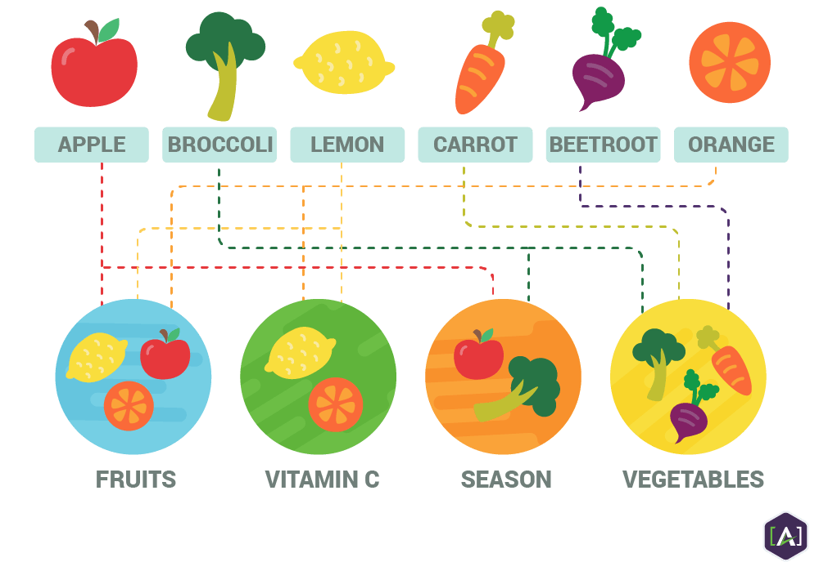
Why Taxonomy? (Recap)
Diverse range of blockchain has emerged since the advent of Bitcoin (2008)
Complex internal structure and many configurations and variants
Comparison of different blockchain is difficult
Lack of product data and technology evaluation resources
Blockchain Taxonomy
Dimensions and categories for classifying blockchains
Understanding blockchain technology
Benefits
Systematically consider the features and configurations of blockchain
Explore the conceptual design space
Compare and evaluate design options
Assess their impact on quality attributes
Notes:
First is a bit recap on why we need a blockchain taxonomy.
Diverse range of blockchain has emerged since the advent of Bitcoin (2008)
Complex internal structure and many configurations and variants
Building application on blockchain need to consider different features and different configurations and their impact on the quality attributes.
Early stage with little product data or reliable technology evaluation available to compare different variant
Presenting taxonomy defines dimensions and categories for classifying blockchains and ways of using them in systems.
Taxonomies have been used in software architecture to understand existing technologies.
Our taxonomy captures major architecturally-relevant characteristics of various blockchains, and indicates their support for various quality attributes.
Performance and quality attributes of blockchain-based systems, as well as core concerns of blockchains like decentralization and the data structure used.
The taxonomy is informed by existing industrial products, technical forums, academic literature, and our own experience of using blockchains and developing prototypes.

Slide 3

Blockchain Taxonomy Dimensions
(De)centralization
Deployment
Ledger Structure
Consensus Protocol
Block Configuration and Data Structure
Auxiliary Blockchain
Anonymity
Incentive
Last lecture
This lecture
Notes:
In the previous lecture, we have learn the first 5 dimensions of the taxonomy. This lecture will cover the last 3 dimensions, including

Slide 4
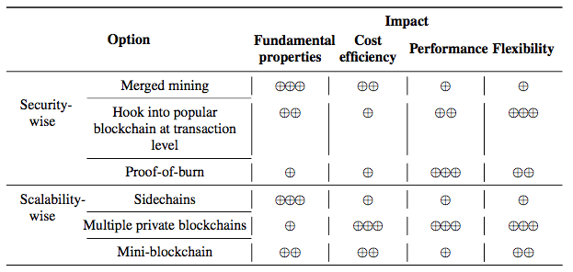
Tradeoff Overview
Notes:
This is an overview of design alternatives of building a auxiliary blockchain.
auxiliary blockchain is a new blockchain, combined with or built on an existing blockchain.
Different strategies used for security and scalability
For security, the new blockchain can be aligned with public blockchains, utilise existing infrastructure, resources, and trust.
For scalability, sidechain or multiple private blockchains could be used in order to improve the overall scalability.

Slide 5
Sidechains vs. Anchoring
Sidechain: another blockchain that is connected (“pegged” from “to peg”) to a main chain, and money can be sent from one to the other
Not necessarily back
Use when you want to create a “smaller” chain, e.g., with lower transaction fees, higher / additional throughput, etc., but benefit from the integrity (through PoW) of a main chain, like Bitcoin
Examples: see following slides
In contrast, “anchoring” or “hooking” your own chain into a main chain (like Bitcoin or Ethereum) gives you high integrity when you don’t need to transfer assets
5 |

Slide 6
Merged Mining 1/5
Mining is ordinarily exclusive
Each attempt either has a chance to be a parent chain block
or has a chance to be a sidechain block
Obstacle to bootstrapping
Miner splits mining resource to mine a new blockchain
Miner switch between parent chain and sidechain
Hash( prev || merkle_root || nonce) < TARGET
Parent chain (Bitcoin)
Hash( prev || merkle_root || nonce) < TARGET
Sidechain
Notes:
The following 5 slides will explain the merged mining in detail.
merge mining is a very clever mechansim to mining two cryptocurencies at the same time
Without merge mining, the ordinary mining on an cryptocurrency is exclusive to a particular cryptocurrency.
Miner divert some of the mining resources to mining new blocks in a cryptocuennty network or on another. You can change it over time, or you could split your resources, but at any one time your hash power has to be divided from its total in this sense.
Now this is an obstacle to bootstrapping new cryptocurrencies.
So Merge mining is a way of designing the mining puzzle for an altcoin, such that every puzzle attempt in a sidechain (which is the new cryptocurency) is also a valid puzzle attempt in parent chain.
Here, we use bitcoin as the parent chain
Each puzzle attempt for this altcoin would be a hash over a string including the hash of a previous block. A merkl_root of transactions with a block, which would be different than Bitcoin transactions, and the miner compare it to the new cryptocureency difficulty target, which would be different than Bitcoins as well.

Slide 7
Merged Mining 2/5
Hash( prev || merkle_root || nonce) < TARGET
Parent chain (bitcoin)
Hash( prev || merkle_root || nonce) < TARGET
Sidechain
Tx₀ (coinbase)
scriptSig:
scriptPubKey: …
Header
Prev
Merkle_root
Sidechain header
Tx₁
Tx₁
Tx₂
Tx₂
…
…
Parent chain block
Sidechain block
Notes:
the scriptSig field of coinbase transaction in Bitcoin isn‘t checked at all by Bitcoin client, so it can be used to store arbitrary data and it would still be a valid Bitcoin block.
So the approach for Merge mining is to, put all of the data needed for the new cryptocurrency encoded in the scriptSig. This includes the previous block hash for the side chainand the merkl_root of transactions in a sidechain bloc.
Miner assemble a block of bitcoin and sidechain, hash the sidechain block, and put the hash into the scriptSig of the bitcoin block, than start mining.
If an mining attemp solves the puzzle at bitcoin difficulty level, bitcoin block is completed and sent to the bitcoin network.
Hash of the sidechain does nothing
If solve the puzzle at sidechain difficulty level, sidechain block is ompleted and sent to sidechain network.
Includes sidechain transactions, sidechain block header, bitcoin block header, and hash of bitcoin transactions (mess). The bitcoin stuff is used to verify the proof-of-work
The two hash chains are fully independent.

Slide 8
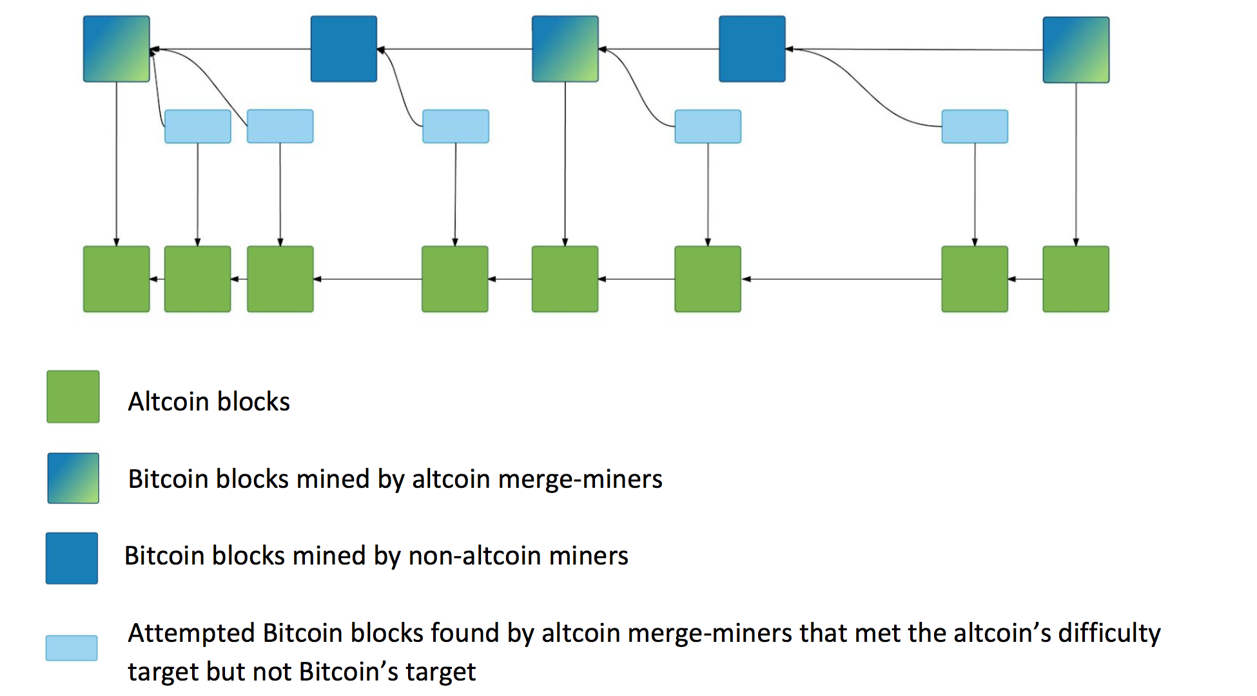
Merged Mining 3/5
Parent chain (Bitcoin)
Sidechain
Notes:
Sidechain’s target will typically be much less than Bitcoin’s target,
some (or even most) sidechain blocks will not be pointed to by valid Bitcoin blocks.
Bitcoin block chain and the sidechain block chain as two parallel chains, with occasional pointers from a Bitcoin block to an sidechain block.
In this example, 60% of Bitcoin miners mine the sidechain, and the sidechain time-between-blocks is 5 minutes.
This means that the sidechain difficulty is 60% * 5 / 10 = 30% of Bitcoin.
Thus, 40% of Bitcoin blocks do not contain hash pointers to altcoin blocks.
every valid altcoin block result from an attempt at mining a Bitcoin block,
but only 30% of them actually meet Bitcoin’s difficulty target. For the other 70% of altcoin blocks, the altcoin network needs to be able to verify the mining puzzle solution. The simple way to do this is to broadcast the Bitcoin near-block in addtion to the altcoin blocks.
But a cleverer way is to broadcast just the header of the Bitcoin near-block and the Merkle proof of inclusion of the Coinbase transaction in the Bitcoin Block

Slide 9
Merged Mining 4/5
Parent chain client
Sidechain block looks like any other Bitcoin block
Hash in scriptSig is ignored
No change
Sidechain client
Interpret Sidechain block
Ignore parent chain transactions
Understand parent chain block
Be able to verify the “work”
Notes:
Bitcoin clients, the sidechain block looks just like any other Bitcoin block, with a hash in the coinbase transaction that can be ignored.
No special support is required
sidechain clients know how to interpret the block by ignoring the Bitcoin transactions and looking at the sidechain transactions committed to by the hash in the coinbase transaction.
while this doesn’t require any changes to Bitcoin, it does require the sidechain to specifically understand Bitcoin and accept merge‐mined blocks.

Slide 10

Merged Mining 5/5
Namecoin is the first blockchain uses merged mining with Bitcoin
A small miner (or mining pool) on a large network can demolish a merged mining blockchain
Jan 2012: CoiledCoin – Eligius pool
Jul 2013: TerraCoin – unknown
Nov 2013: WorldCoin – unknown
Many mining pools merge-mine several sidechains
Ghash.IO: Bitcoin, Namecoin, IXCoin, Devcoin
Notes:
Namecoin is the first blockchain uses merged mining with Bitcoin
Because mergemined side chain reuses the compoutational power provided by another rblockchain network. A smll miner or mining pool on a large network can demolish a merged mining blockchain.
There's a well-known story of an coin called CoiledCoin, which was quite small, during the time of 2012, and one of the large mining pools, decided that CoiledCoin was a scam, and a very bad idea.
And so the director of this Eligius pool pointed his resources at CoiledCoin and launched an attack.
This attack involved mining a lot of blocks that reversed days of transaction history in CoiledCoin. And as well as mining a long chain that had empty blocks containing no transactions at all effectively making a denial of service attack.
CoiledCoin users weren’t able to make any transactions during that time.
After a fairly short time of the siege, all of the users of CoiledCoin had left.
Merge mining makes it cheaper for attackers since the attackers don’t even have to stopping mining Bitcoin while it launches this attack.

Slide 11
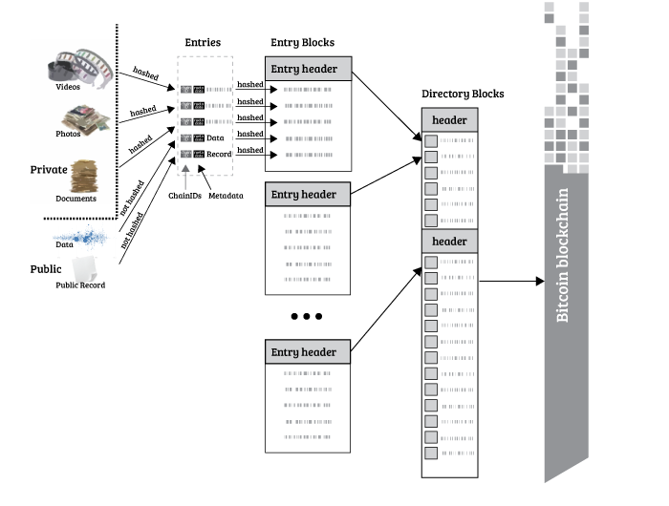

Hooking into Public Blockchain at Tx Level
On the Tx level:
Sidechain Tx is embedded in transaction of parent blockchain (e.g., via OP_RETURN)
On the block level:
Write root of Merkle tree into public blockchain
Bitcoin: e.g., via OP_RETURN
Ethereum: e.g., into an array in a smart contract
Notes:
A more loosely coupled way is to hook the new blockchain into a public block- chain,
Such anchoring can happen on both the transaction level or at block level.
ON transaction level, the sidechain transaction is embedded in transaction of parent blockchain (via OP_RETURN)
On blockchain level, the root of merkle tree can be witten to public blockchain, for example, using OP-Return on Bitcoin or as a smart contract variable on Ethereum.
For instance, Factom anchors into the Bitcoin blockchain by submitting a transaction to the Bitcoin blockchain every 10 minutes, with the current hash of the Factom blockchain.

Slide 12
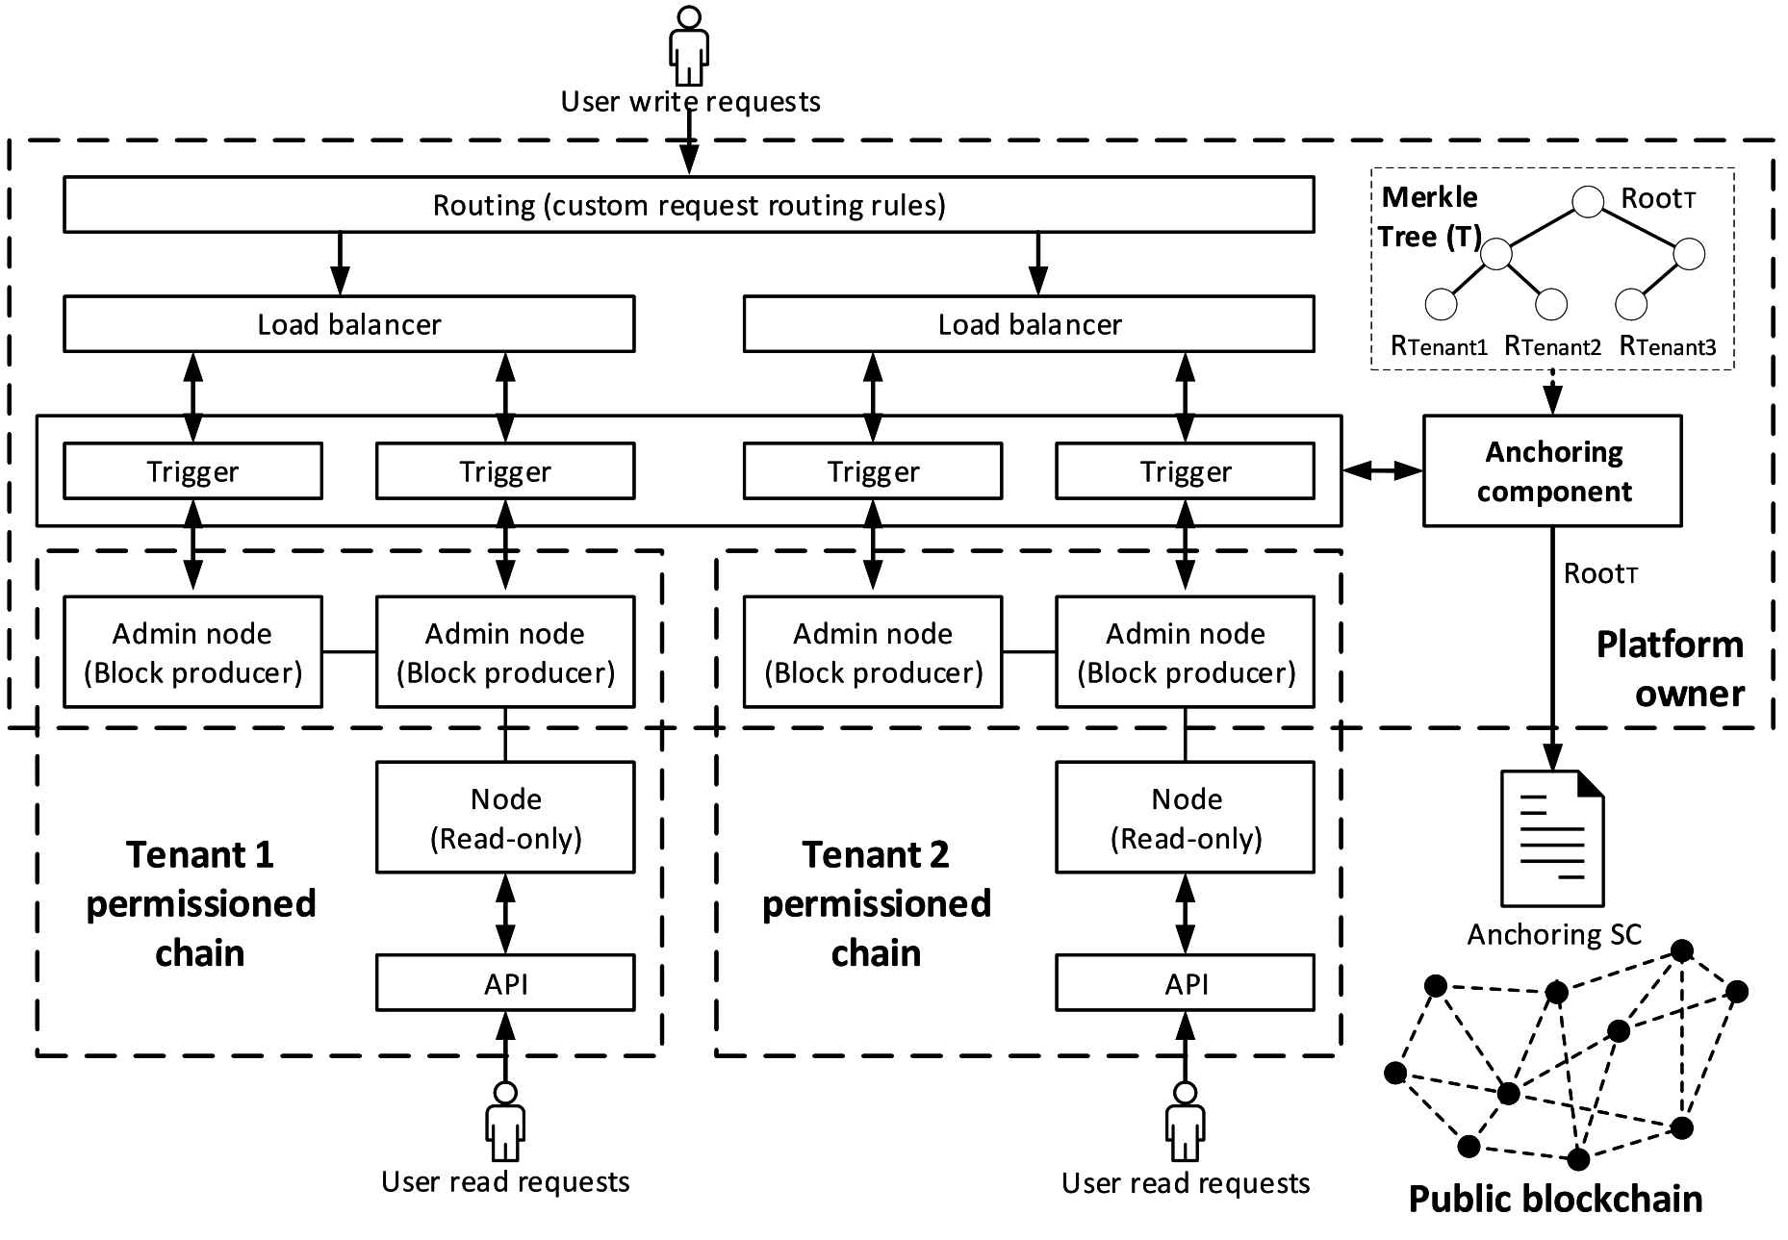
Anchoring for multi-tenant system
Have a number of permissioned chains
E.g., one per tenant
Combine the roots of the Merkle trees into one higher-level Merkle tree
Anchor its root into public chain
Source: Ingo Weber, Qinghua Lu, An Binh Tran, Amit Deshmukh, Marek Gorski, and Markus Strazds. A platform architecture for multi-tenant blockchain-based systems. In ICSA'19: IEEE International Conference on Software Architecture, Hamburg, Germany, April 2019.
12 |

Slide 13



Student Task
In the example on the previous slide, we had one permissioned chain per tenant
Think for 1 minute about alternative purposes for which to create permissioned anchored chains
Detailed design will be discussed in the First Guest lecture
13 |

Slide 14
Sidechain 1/5
Unilateral peg
Bilateral peg
1 Token deleted forever
1 Token created
Main chain
Sidechain
1 Token held in escrow
1 Token created
Main chain
Sidechain
1 Token released
1 Token destroyed
Main chain
Sidechain
Notes:
The following 5 slides will explain side chain in more details
There are two types o f sidechains, including unilateral pegged side chain, and bilateral pegged sidechain.
unilateral peg means is that one unit of the token of the main chain is deleted in order to claim one unit of token of the sidechain.
No way to get a token of the main chain back.
The only way is to trade the token from sidechain with someone else who already has tokens of the mainchain,
The token of the main chain that you had is already been taken out the money supply, irreversibly.
However, bilateral peg allow users to deposit the token of the main chain in some place
Users are able to get one unit of token of the side chain, and then transact with it in different ways.
But eventually you could take that token of the main chain from its escrow storage.

Slide 15
Sidechain 2/5
Proof-of-Burn
Snapshot
Main chain
Sidechain
Signed by sk_{A}
Signed by sk_{A}
BurnCoin value: v
GenCoin value: v’
Signed by the same private key
Same signature scheme
Main chain
Sidechain
Signed by sk_{A}
Signed by sk_{B}
Out 1: Addr B; value: v₁
Out 1: Addr C; value: v₂
GenCoin value: v₁’
Signed by sk_{C}
GenCoin value: v₂’
Notes:
There are two ways to get tokens of a unilateral pegged side chains.
The first is proof-of-burn, where GenCoin transaction takes a proof-of-burn transaction from the main chain as input. GenCoin is signed by the same private key that signed the proof-of-burn (and using the same signature scheme).
Ensures that the same user who burned the tokens from the main chain also created the tokens on the sidechain.
The second way is snapshot, which
use ownership of the token of the mainchain without burning them to claim the tokens on the side chain.
First, define a block height during which anyone who owned an unspent Bitcoin transaction output would be able to claim a proportional amount of sidechain tokens.
In this case, there is no fixed relationship between the price of a bitcoin and the price of an sidechain tokens, because bitcoins are not being converted to sidechain tokens via proof-of-burn
Associating one altcoin unit to one bitcoin doesn’t actually make it worth on bitcoin.
It ensures instead that the altcoin will be worth at most one bitcoin, since one bitcoin can always be cashed in for an altcoin, but not vice versa.

Slide 16
Sidechain 3/5
Bilateral pegged sidechain is a voting system
A group of custodians cast vote on
when to unlock tokens
where to send the unlocked tokens to
Single Custodian
Multi-sig Federation
Notes:
Security model of bilateral pegged sidechain is like to having a group of custodians cast votes on when to unlock bitcoins and where to send the unlocked bitcoins to.
Here we can either have a single custodian or a muli-sig federation

Slide 17

Single Custodian
Sidechain 4/5
Lock parent token Tx
Unlock parent token Tx
Parent chain
Exchange
Wallet on parent chain
Wallet on sidechain
Sidechain
Unlock parent token Tx
Lock parent token Tx
Notes:
Here, a Central exchange is used as a single custodian, which holding custody of the locked bitcoins and holding custody of unlocked equivalent tokens on the sidechain.
The central exchange manually enforce the promise of locking bitcoins before unlocking tokens on the sidechain.
Having one party control the frozen funds sent to a sidechain is similar to simply depositing funds at bitcoin banks such as Coinbase.
internal ledgers of these bitcoin banks can be viewed as as sidechains to Bitcoin.

Slide 18


Sidechain 5/5
Lock parent token Tx
Unlock parent token Tx
Parent chain
Exchange
sign
Multi-Sig Federation
Notary 1
Multi-sig wallet on parent chain
Multi-sig wallet on sidechain
Notary 2
sign
Sidechain
Unlock parent token Tx
Lock parent token Tx
Notes:
A more decentralized design is to have a group of notaries control of a multi-signature, where the majority of them has to approve the unlock of funds.
This setup is better than having a single controller of the funds, but may still centralize control.
To achieve true decentralization, the notaries should be carefully selected so they are located in different jurisdictions, different geographical locations, and each having good reputation and good security.

Slide 19
Problems of Sidechain
Public sidechain might not have settlement finality
Probabilistic assurance only
Parent chain can never be 100% sure if a sidechain transaction has been accepted by the network
Either does sidechain
Bitcoin-backed sidechains requires a soft-fork or hard-fork for Bitcoin to add new complex opcodes.
Notes:
Most public blockchains do not have settlement finality.
If the side chain does not have settlement finality, then the Bitcoin blockchain can never be sure if a side chain transaction has been accepted by the sidechain network.
All it can get is a probablistic assurance: more proof-of-work confirming a transaction means it bas been more probable accepted.
Sidechains in Bitcoin requires a soft-fork or hard-fork to add new complex opcodes.

Slide 20
Entangled Blockchains
Reversal of the lock Tx in parent blockchain → Reversal of the unlock Tx in the sidechain blockchain
Sidechain Tx is embedded in transaction of parent blockchain (OP_RETURN)
Sidechain block has extra parent in the parent blockchain
Sidechain blockchain nodes verify that parents
Sidechain block is anchored by cryptographic commitments in parent blockchain Tx
Sidechain client maintains a copy of Bitcoin blockchain
Downside: considerable overhead on clients
Notes:
One way to overcome the lack of transaction finality for the bilateral pegged sidechain is to entangle both blockchains
such as the reversal of the lock transaction in the parent blockchain implies the reversal of the unlock transaction in the sidechain. There are several ways to entangle blockchains:
Sidechain blocks have two parents, one in the sidechain blockchain and one in the parent blockchain.
Sidechain blocks are anchored by cryptographic commitments in the parent blockchain transactions

Slide 21

Shading 1/5
Full nodes require sizeable storage space
Bitcoin > 200GB
Ethereum ~ 200GB (“fresh” full node) – 2.5TB (archive node)
Sharding
Divide the blockchain state into pieces
Participating blockchain nodes only hold some shards
Transaction sharding vs. State sharding
Notes:
Sharding is another way to improve scalability of blockchain.
The full nodes of most blockchain networks need to keep all historical transactions and the state of blockchain network, which requires sizeable storage space.
These sizes keep growing.
To reduce the storage burden of blockchain participants and address other scalability concerns, the concept of sharding has been applied to blockchain
Which divide the blockchain state into pieces, and participating blockchain nodes only hold some shards.
There are two different types of sharing, namely transaction sharing and state sharding.

Slide 22

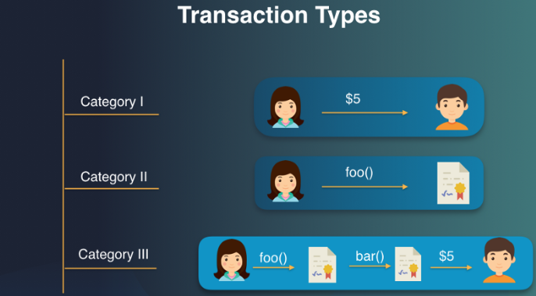
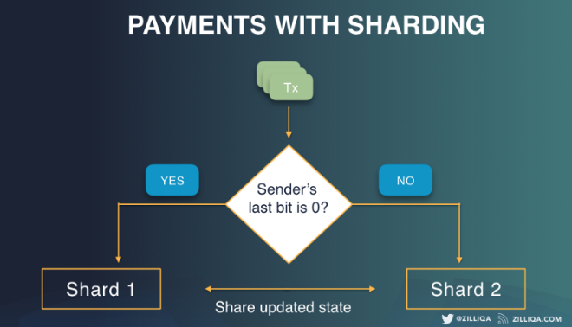
Sharding 2/5
Transaction Sharding
Notes:
Zilliqa is a blockchain platform using sharing mechanism.
Where Different transactions use different sharing strategy
It classified transactions into 3 categories: basic money transfer, smart contract function call, without calling other smart contract. Only involves an account and a smart contract.
Other transactions, invoke a chain of contracts and terminate with a user account.
Category III transaction can be divided into several transactions of the first two types.
In order to assign payment transactions in a network with two shard S1 and S2, we first check sender’s address. If the address ends with 0, then it assigned to S1. If the address ends with1, then it assigned to S2.

Slide 23
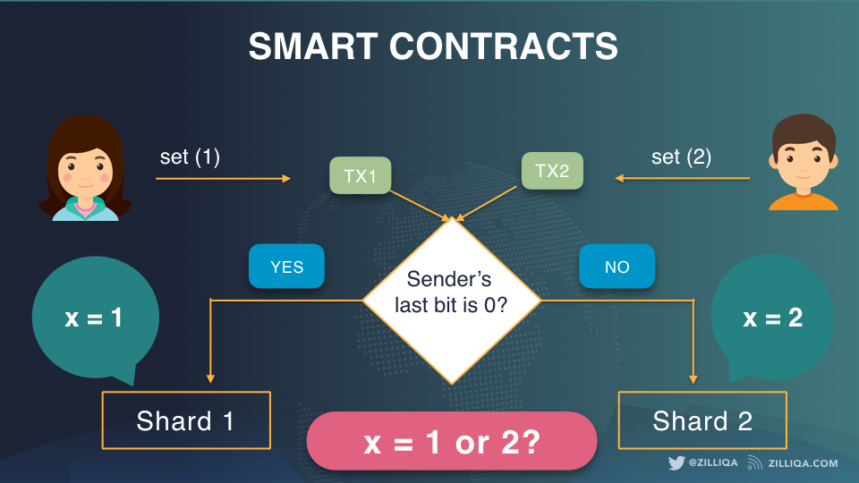
Sharding 3/5
Conflicting state
Using the recipient address instead
Smart contract address
Notes:
For the second transaction type, the smart contracts address is used to assign the transaction into different shards

Slide 24

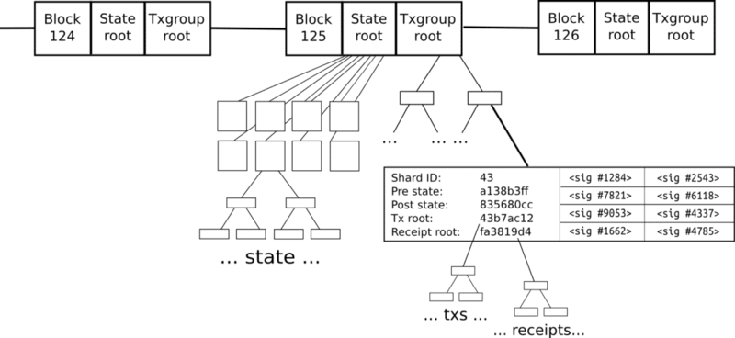
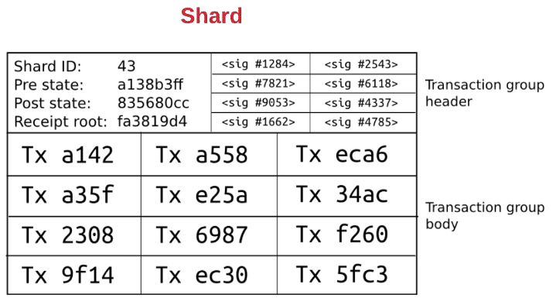
Sharding 4/5
After sharding is activated
The state is split into shards
Each unique account is in one shard
Accounts can easily transact with other accounts within the same shard
Two levels of interaction
Random validator who need to verify the transactions in the shard
Notes:
https://blockgeeks.com/guides/what-are-ethereum-nodes-and-sharding/
sharding in ethereum will support state sharding
Each of the shard will have its own unique features and everyone belonging to the shard i.e. The accounts, can interact with each other.
If they want to contact with other shard, they will have to use another cross-shard protocol.
Ethereum suggests to have two levels of interactions.
First level is a shard,
Shard ID: The ID of the shard that the transaction group belongs to.
Pre-state root: This the state of the root of shard 43 before the transactions were applied.
Post state root: This is the state of the root of shard 43 after the transactions are applied.
Receipt root: The receipt root after all the transactions in shard 43 are applied.
Random validators who need to verify the transactions in the shard.
Top level
State root represents the entire state, broken into shards
Accept transaction groups rather than single transactions
Transaction group is valid if 1) pre-state root matches the shard root in the global state and 2) signatures in the transaction group are all validated
After transaction gets in, the global state root becomes the post-state root of that shard ID

Slide 25
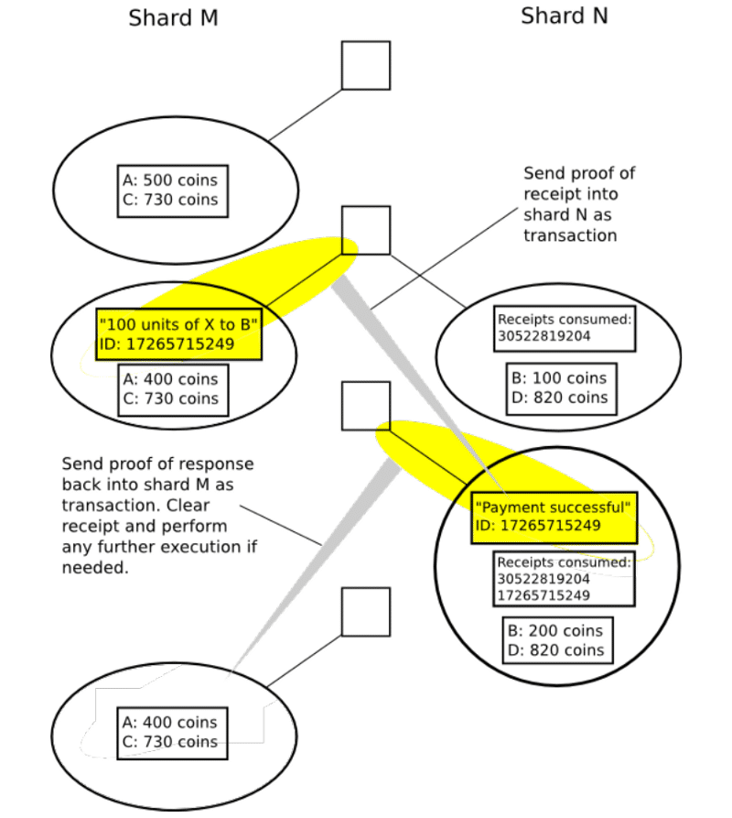
Sharding 5/5
Cross-shard communication
Receipt of transaction can be accessed via Multiple Merkle trees from the the transaction group Merkle root
Transaction does
Change the state of shard
Generate a receipt
Receipts are stored in a distributed shared memory
Seen by other shards, but not modified by them
Notes:
- The cross-shart communication is based on rhe receipt of transactions, which can be accessed via multiple merkle trees from the transaction group merkle root.
- A transaction changes the state of a shard, and generates a receipt, which is stored in a distributed shared memory that can be seen by other shartds, but not modified by them.

Slide 26
Student Task
Think about sharding: how would you split a network into shards?
26 |

Slide 27
Blockchain Taxonomy Dimensions
(De)centralization
Deployment
Ledger Structure
Consensus Protocol
Block Configuration and Data Structure
Auxiliary Blockchain
Anonymity
Incentive

Slide 28


Bitcoin is Psedonymous
Tor is a intermediary server
Hidden IP address
Hidden users surfing on it
Bitcoin is psedonymous (pseudo-anonymous)
Bitcoin transactions can be linked to compromise the anonymity of Bitcoin users
Silk Road
“eBay for drugs”
Cash flow of at least USD213 million
Combination Tor and Bitcoin
FBI investigation
Exposed physical IP address of the Silk Road server
Iceland
Customer service manager is arrested
Link Ulbricht with “Dread Pirate Roberts”
FBI became the second largest owner of Bitcoins
144, 000bitcoins
Notes:
https://medium.com/@marcell74/the-silk-road-a-real-thriller-and-the-truth-about-the-anonymity-of-bitcoin-198b519ca397
Bitcoin is psedonomous. It means that bitcoin transactions can be linked to compromise the anonymity of bitcoin users. The story of silk road is a good example to show this problem.
Silk road is a trading platform for illegal stuff on dark web
Supported by Tor and Bitcoin. Users can hide their IP address behind Tor.
And using Bitcoin can hide their physical identity.
The story starts from a silk road customer posted on a Reddit forum asking the Tor’s configuration that shows the actual physical IP address of the server
FBI tracked down the IP address and found the server is located in iceland. But they do Not know who own the server or how it works.
They pretend to be a customer to chat with the customer service manager, who is then arrested.
FBI researched who was the first to talk about silk road in online forum, assuming the person could be the inventor. They found Ulbricht
And began surveillance. They found every time he open his computer, dread pirate Roberts login
Eventually, Ulbricht was arrested and found guilty and sentenced to life imprisonment
FBI seizes the Bitcoins from Icelandic server.

Slide 29
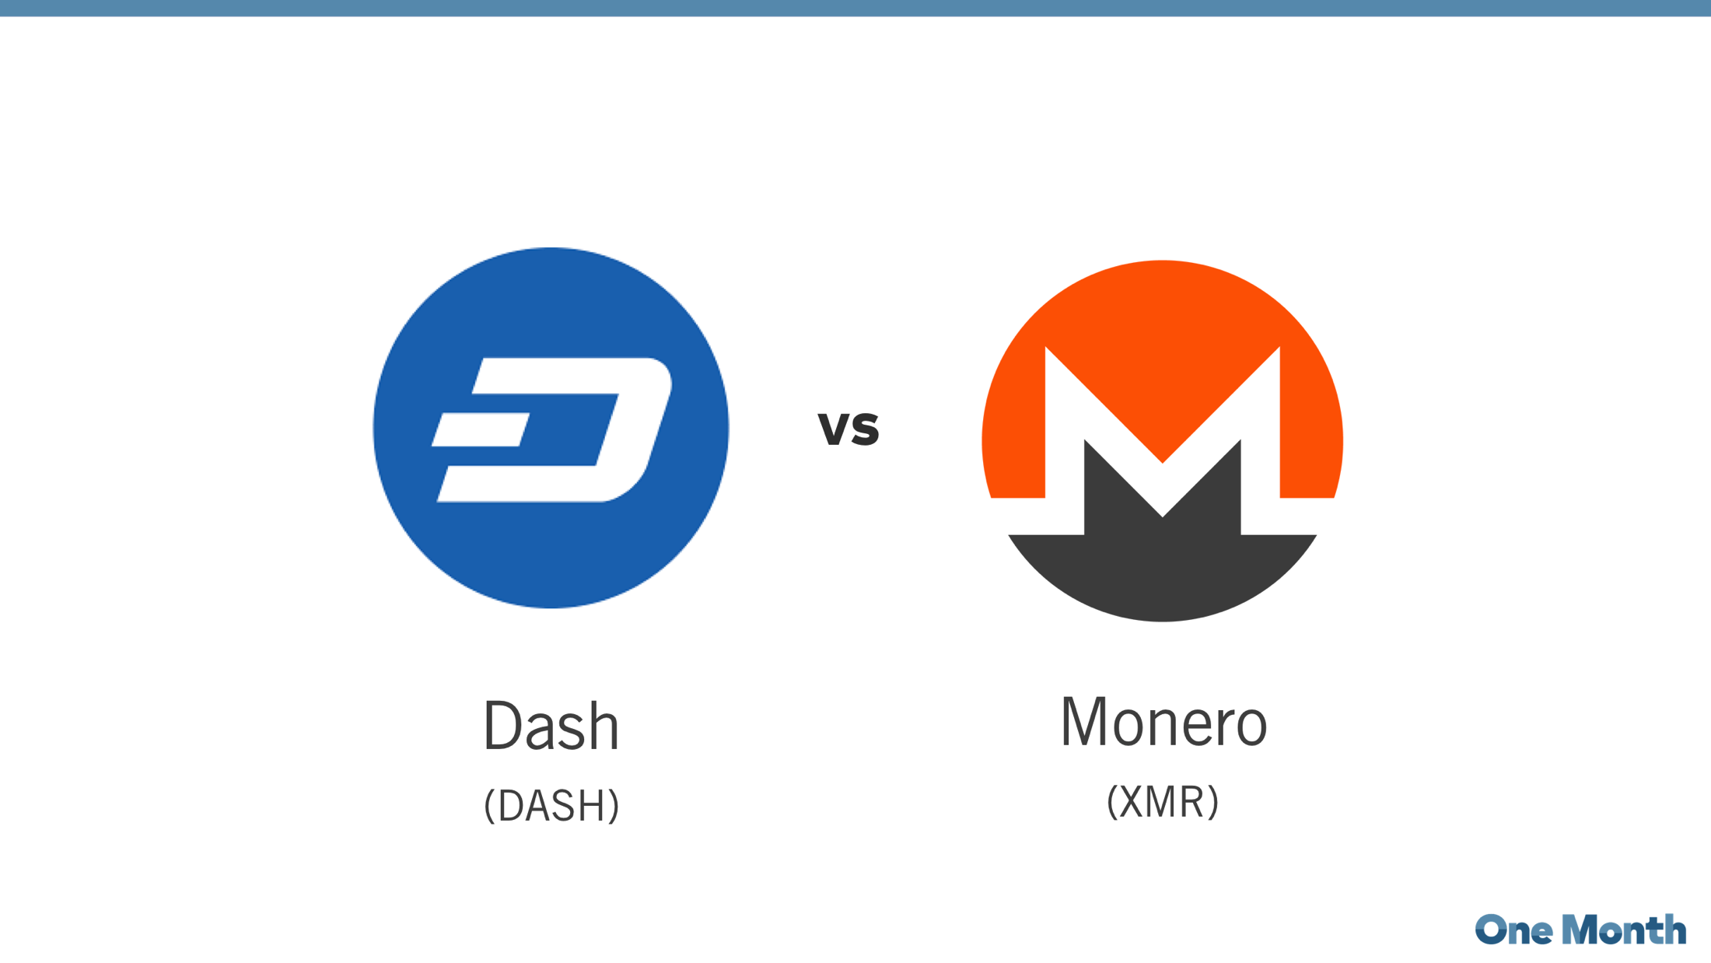
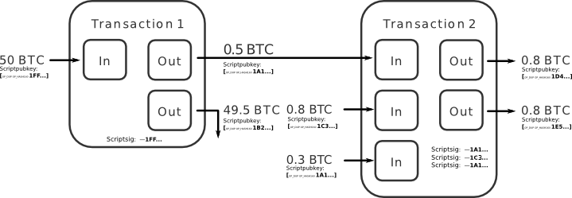
Mixing Services
Mixing service
Group transactions together with multiple input addresses and output addresses
Hard to track which output address is paid by which input address
A series of mixing services can be linked sequentially
Mixed transactions are uniform in value
Dash: Pre-anonymize founds through mixing rounds
Monero: Ring signature
Notes:
Different techniques are proposed to preserve data privacy. Mixing service is one of the technique.
Mixing services offer an alternative method for anonymisation.
A mixing service groups several transactions together so that a payment contains multiple input addresses and multiple output addresses.
If the mixed transactions are uniform in value, the traceability between input and output addresses is minimised.
A centralised mixing service requires a third party to operate
Some blockchains have a kind of native, built-in mixing service, including Dash and Monero.
Dash preanonymizes funds of users through mixing rounds, so that the funds can later be spent without delay
Monero uses ring signatures, such that the sender of a transaction cannot be identified among a group of possible senders.

Slide 30

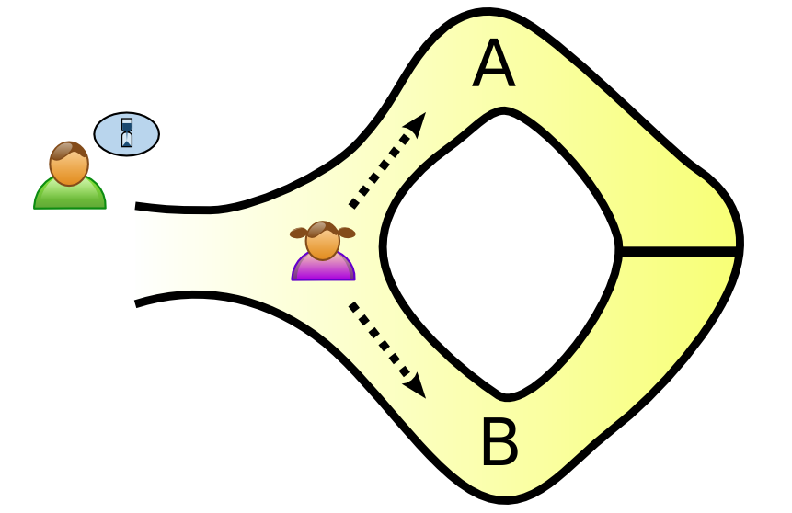
Advanced Cryptographic Technology
Zcash
Encrypted payment information in transaction
Cartographical method to verify the validity of the encrypted transaction
Zero-knowledge proof
Zero-knowledge proof
Allow the blockchain network to maintain a secure ledger
Enable private payment without disclosing the parties or amounts involved
You have a secret that you don’t want others to know, but you want to proof you have the secret.
Notes:
There are some techniques using more advanced cryptographic techonolgoly to provide ananomity ,
For example, zeroknowlege proof used by Zcash, which encrypt payment information in transaction.
Zero-knolwege prrof allowes blockchain network to maintain a secure ledger, and enable sprivate payment without disclosing the parties or amount involved.
Zero-knowledge proof is like You have a secret that you don’t want others to know, but you want to proof you have the secret
Here is a simple example to show how zero-knowledge proof works.
Alice discovers the secret phrase to open a secret door in a strange cave.
The cave is shaped like a ring with the secret door blocking the paths from connecting at the end.
Bob wants to know the secret word, but Alice will not reveal it to him.
they label the two pathways A and B.
Alice takes a path while Bob waits outside and cannot see which path she chooses.
Bob enters the cave and shouts which path he wants Alice to return on.
Because Alice has the secret phrase to the door, she can return on either path, easily returning on the path that Bob shouts.
She also does not need to reveal the secret phrase in order to do so.
If Alice does not know the secret word, she will have a 50 percent chance of returning on the desired path.
Since she has the secret phrase, her ability to return on the desired path consistently demonstrates to Bob (with extremely high probability) that she knows the secret phrase.

Slide 31
Blockchain Taxonomy Dimensions
(De)centralization
Deployment
Ledger Structure
Consensus Protocol
Block Configuration and Data Structure
Auxiliary Blockchain
Anonymity
Incentive
Notes:
The last dimension of the blockchain taxonomy is incentive mechanism.

Slide 32


Incentive
Financial incentive in the cryptocurrencies
Join the network
Validate transactions
Generate blocks
Execute smart contract
Bitcoin
Reward for generating new blocks and fees associated with transactions
Ethereum
Fee to execute smart contract
Enigma
Fixed price for storage, data retrieval and computation within the network
Security deposit
Notes:
Enigma also requires a security deposit for nodes to join the network. If a node is found to lie, its deposit will be split among the honest nodes.

Slide 33
Summary
Varieties of Blockchain – A Taxonomy
(De)centralization
Deployment
Ledger Structure
Consensus Protocol
Block Configuration and Data Structure
Auxiliary Blockchain
Anonymity
Incentive
Notes:
This lecture covers the last 3 dimensions of the blockchain application taxonomy, including auxiliary blockchain, anonymity and incentive.
Auxiliary blockchain is a new blockchain that is combined with or built on an existing blockchain.
There are different strategies used by an auxiliary blockchain in order to leverage the security level or computational source of an existing public blockchain, like merge mining or anchoring.
Using side chain or multiple private blockchains, or shading could improve the scalability of the system.
Regarding anonymity. Most blockchains, like bitcoin, is psedonomous. It means that bitcoin transactions can be linked together, especially combined with other evidence gathered from physical world, in order to compromise the anonymity of bitcoin users.
Finlay, we learn the incentive mechanisms provided in different types of blockchains that incentivize participants to join the network, validate transaction and execute smart contracts.

Slide 34
Blockchain Application Design Process
COMP6452 Software Architecture for Blockchain Applications
Xiwei (Sherry) Xu
| Senior Research Scientist @ AAP team, CSIRO Data61
| Xiwei.Xu@data61.csiro.au
Notes:
Now, let’s look the second topic of this lecture, which is blockchain application design process.

Slide 35

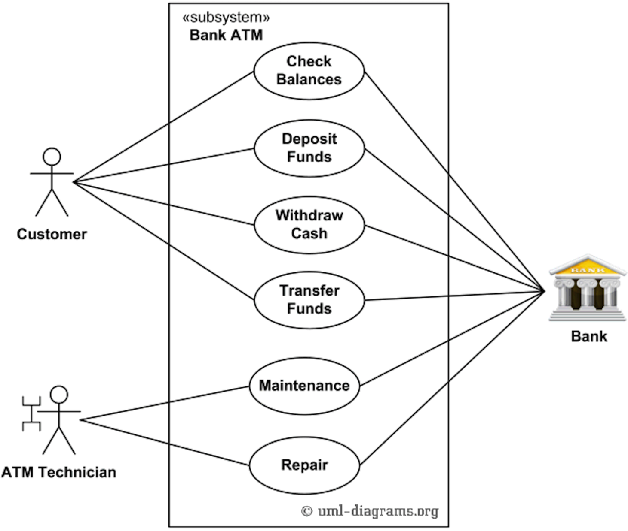
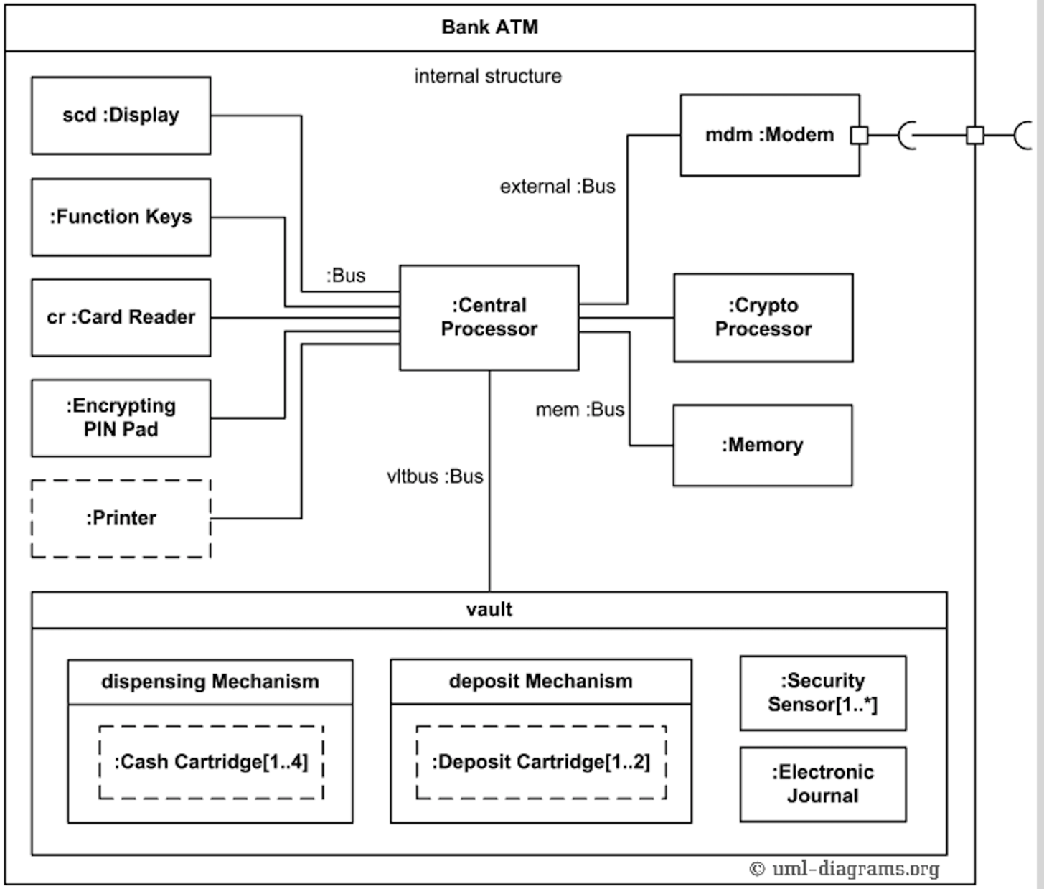


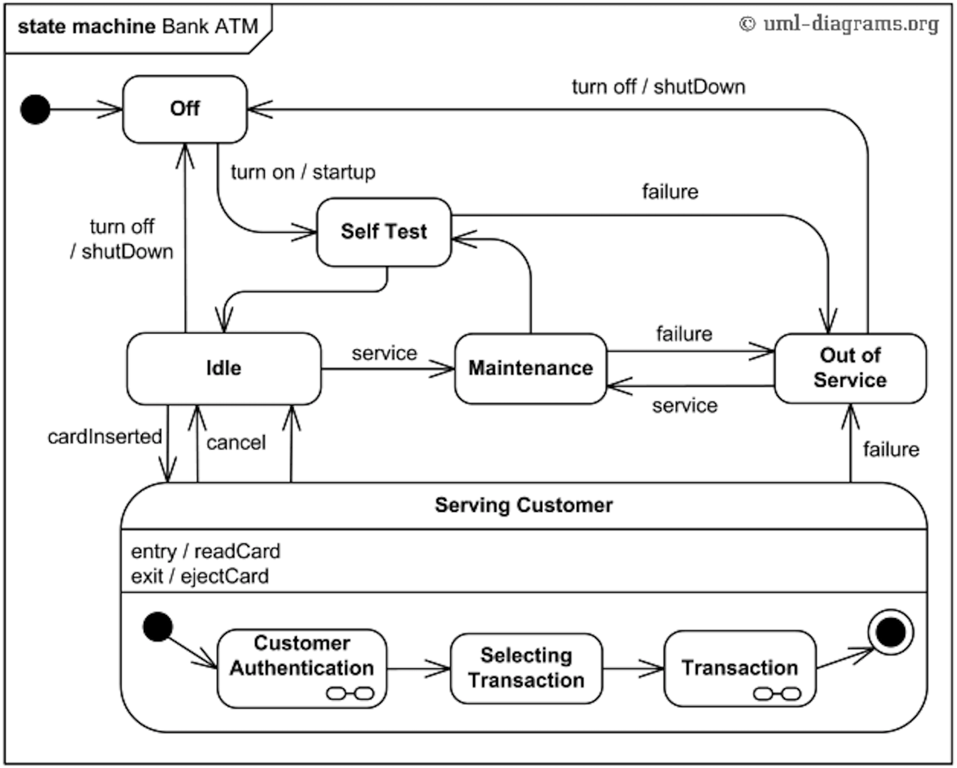






Design Process
A common method is to create multiple designs and perform comparative evaluation.
Business goals
Requirements
Traceability
Software Architecture Design
Evaluation and Decision Making
Implementation
Architectural constraints
Refine
Ideas
Notes:
This diagram shows a design process from architecture perspective from architecture perspective.
Software design is a creative process starts from high-level business goals, then, functional requirements and non-functional requirement are gathered with many conflicting architectural constraints.
After that is an iterative process including proposing solution and evaluating the proposed solution. A comment method is to create multiple design alternatives and perform comparative evaluation.
The final design of a software system after iterations is the result of many design choices about the selection, configuration, and integration of software, hardware, and communications components.
Such artifacts are then used to implement the system.

Slide 36
Architecture Analysis Methods
Non-Functional Properties arise from Architectural Design Choices
Analysis is one of the important uses of models
e.g. does this design support service availability?
(Qualitative) fault-tree statistical analysis
(Qualitative) failure scenarios
e.g. What is the transaction latency in this design?
(Quantitative) Simulation-based prediction of latency distributions
(Quantitative) Formula-based calculation of average latency
e.g. Will this design ensure confidentiality?
e.g. Is this design easily modifiable?
Different kinds of models allow different kinds of analyses
Notes:
- As we learned in the earlier lectures, software architecture is a model of a software system. Non-functional properties of the system arise from architectural design choiced.
As a model, software architecture is always used to analyze the quality attributes of the system.
Below are several questions we could ask if we have a software architecture in our hand.
For example We can ask the question does this design support service availability?
To answer the question, we could use a qualiatative method, like fault-tree statistical analyses, or a qualitative method, like failure scenarios analysis.
Or we could ask what is the transaction latency in this design?
To answer the question, again, we could follow a quantitative method to use simulation to predict the latency distribution. We can also use another quantitative method to calculate average latency based on formula.
Different kinds of models allow different kinds of analyses.

Slide 37
Design Trade-offs
Often, improving one quality will hurt another one
e.g. Use a bigger server
faster, but more expensive
e.g. Use redundant servers
better availability (hot fail-over)? Or better performance (load balancing)? Worse write latency? More expensive
What are the trade-offs? How should you choose?
Specific methods exist to help
ATAM: Architecture Trade-off Analysis Method
Multi-criteria decision-making methods
Goal: determine if the architecture can achieve the NFRs before developing a system (which is typically a big investment)
Notes:
- As we learnt before, every decision decision is a trade-off between different quality attributes.
Often, improving one quality will hurt another one.
e.g. Use a bigger server is faster, but more expensive
e.g. Using a redundant servers could achieve better availability via hot fail-over. This decision can also improve performance via load balancing. However, it may lead to longer write latency and also rore expensive
The question we ask during the design process is what are the trade-offs? And how should you choose?
There are some existing methods that can help us to answer these questions. For example, ATAM: Architecture Trade-off Analysis Method and Multi-criteria decision-making methods.
The goal of using these methods is to determine if the architecture can achieve the non functional requirements before developing a system, which is typically a big investment.

Slide 38
ATAM: Architecture Trade-off Analysis Method
Presentation
Present ATAM to stakeholders
Present Business Drivers (NFRs and business goals)
Present Current Architecture
Investigation & Analysis
Identify Architectural Approaches
Generate Quality Attribute Utility Tree (& initial use case scenarios)
Analyse Architectural Approaches (for high-priority factors from step 5)
Brainstorm & Prioritise Scenarios
Analyse Architectural Approaches (using scenarios as test cases)
Reporting
Present Results (summary, risks, sensitivities/trade-offs, …)
Notes:
- This is a simplified instruction for ATAM, including 3 stages: presentation, investigation & analysis, and reporting.
During the presentation, the software architect needs to present ATAM to the stakeholders, then presents the business drivers of the design, including NFRs and business goals, followed by the current architecture.
During the stage of investigation and analysis, first different architectural approaches to the system are presented by the team, and discussed.
A quality attribute utility tree is generated which defines the core business and technical requirements of the system, and map them to an appropriate architectural property. Present a scenario for this given requirement.
The next step is to analyze architectural approaches. When each scenario is analysed and prioritized. The architecture is then evaluated against each scenario.
Brainstorm and prioritize scenarios – among the larger stakeholder group, present the current scenarios, and expand.
Then analysing architectural approaches is performance again with the added knowledge of the larger stakeholder community.
The last stage is to report results, which includes a summary, risked, sensitivities and trade-offs etc.

Slide 39
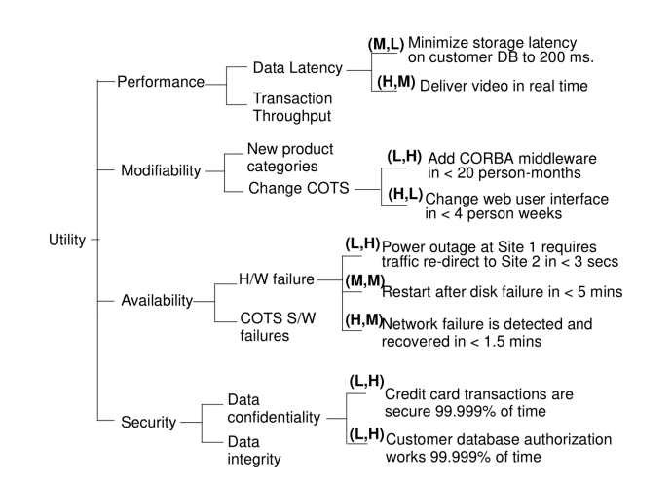
ATAM Quality Attribute Utility Tree
Legend:
(Importance, Risk to Achieve)
Utility trees make system goals more specific and more concrete
Allows understanding relative importance of NFRs → deciding on priority
Example from “ATAM: Method for Architecture Evaluation” (Kazman et al., 2000)
https://resources.sei.cmu.edu/asset_files/TechnicalReport/2000_005_001_13706.pdf
Notes:
Utility trees provide a top-down mechanism for directly and efficiently translating the business drivers of a system into concrete quality attribute scenarios. For example, in an e-commerce system two of the business drivers might be first, “ensuring the privacy of our customers’ data”; and “modifiability is central to respond quickly to a rapidly evolving and very competitive marketplace.” Before we can assess the architecture, these system goals must be made more specific and more concrete. Utility trees help to concretize and prioritize quality goals. An example of a utility tree is shown in Figure 3.
The utility tree contains utility as the root node. This is an expression of the overall “goodness” of the system. Typically the quality attributes of performance, modifiability, security, and availability are the high-level nodes immediately under utility, although different stakeholder groups may add their own quality attributes
Under each of these quality are specific qualities. For example, performance is broken down into “data latency” and “transaction throughput”. This is a step toward refining the attribute goals to be concrete enough for prioritization. Data latency is then further refined into “Minimize storage latency on customer database” and “Deliver video in real-time.” Further work on these scenarios would, in fact, make these architectural response goals even more specific.
These leaf nodes are now specific enough to be prioritized relative to each other. This prioritization use relative rankings such as High, Medium, and Low; The prioritization of the utility tree is done along two dimensions: by the importance of each node to the success of the system and the degree of perceived risk posed by the achievement of this node (i.e., how easy the architecture teams feel this level of performance). For example, “Minimize storage latency on customer database” has priorities of (M,L), meaning that it is of medium importance to the success of the system and low risk to achieve, while “Deliver video in real time” has priorities of (H,M), meaning that it is highly important to the success of the system and the achievement of this scenario is perceived to be of medium risk.

Slide 40
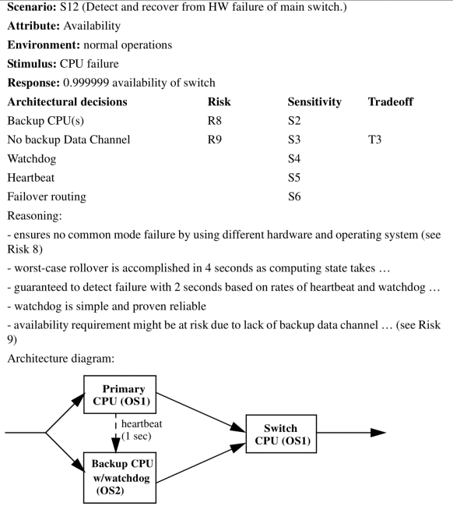
ATAM Scenarios
Scenarios are commonly used in Software Architecture
In ATAM, links attributes, risks, trade-offs, & reasoning about architecture design
Qualitative – identify and evaluate risks
Methodical, but not exhaustive
In ATAM, stakeholders vote on importance of scenarios
Example from “ATAM: Method for Architecture Evaluation” (Kazman et al., 2000)
https://resources.sei.cmu.edu/asset_files/TechnicalReport/2000_005_001_13706.pdf
Notes:
Scenario is another important element used in ATAM.
Scenarios are commonly used in Software Architecture. In ATAM, links attributes, risks, trade-offs, & reasoning about architecture design
The diagram on the left hand side is an example of a scenario about detect and recover from HW failure of main switch. the risks sensitivity points and trade-offs listed in this scenario are pointers to other documetns.

Slide 41
Design Process
Next Lecture
Every step is a procedure to decide between alternative options
Taxonomy
Systematic comparison of different design options
Notes:
Now, let’s look at the design process for the blockchain applications.
Every step of this process is a procedure to decide between alternative options.
The available options discussed in the taxonomy for blockchain applications are used to assist decision-making and to guide the system design at different stages of the design process.
This enables a systematic comparison of different design options.
The design process starts form assessing the suitability of using blockchain, which will be covered in the next lecture.
If blockchain is suitable to the use case in hand,
The second concern to consider is whether a trusted authority is required in the scenario, if there is, the next step is to decentralize the authority.
After that is the main design decision we always talk about, which is what’s on chain what’s off chain? Concerns we need to consider including whether the data is desired to be mutable or immutable, whether the data is big or small, or whether the data is critical or not.
After that we need to select an appropriate blockchain platform, and specific configuration of the platform and block before selecting an appropriate way for deployment.

Slide 42
Trade-off Analysis 1/2
Quality | Design decision
Scalability | Block size, Block frequency
Security | Consensus protocol
Cost efficiency | Public/Consortium/Private blockchain
Performance | Data structure
Design decision
Improve the performance of one quality attribute
… but harm the performance of other quality attributes
Notes:
There are trade-offs between quality attributes in the design of blockchain-based systems.
Different design decisions mainly affect different quality attributes.
block size and frequency mainly affect scalability,
security (like consensus protocol),
cost efficiency (like type of blockchain) or
performance (like data structure).
Design decisions that improve the performance of one quality attribute for a system may harm the performance of other quality attributes. Some simple examples of this impact are discussed in the following slide.

Slide 43
Trade-off Analysis 2/2
Encrypting data before storing it on a blockchain
Increase confidentiality
Reduce performance, may harm transparency or independent auditability
Storing only a hash of data on-chain and keeping the contents off-chain
Improve confidentiality and performance
Partly undermine the benefit of blockchains in providing distributed trust
Single point of failure reduces system availability and reliability
Using private blockchain instead of public blockchain
Allow greater control over the admittance of processing nodes and transaction into the system
Increase barriers to entry for participation, thus partly reduce some benefit of using blockchain
Higher number of confirmation blocks
Increase confidence in integrity and durability of transaction
Harm latency
Notes:
For blockchains that use Nakamoto consensus such as Bitcoin or Ethereum,
waiting for a higher number of confirmation blocks may increase confidence in integrity and durability of transactions,
but will harm latency and thus may impact the performance.

Slide 44
Decentralisation
Blockchain is used in scenarios
…where no single trusted authority is required
…where the trusted authorities can be decentralized or partially decentralized
Spectrum: deployment and operation of system
Some components or functions are decentralized while others are centralized
Centralized monopolies
Central parties with a competition between parties
Services provided jointly by a consortia
Full open service provision in a peer-to-peer system
Notes:
Look at the design process again
After evaluating the suitability of using blockchain, the next step is to decentralize the trusted authority if there is any
For the deployment and operation of systems, there is a spectrum of options ranging from centralised monopolies, to central parties with a competition between parties, to services provided jointly by a consortia, through to fully open service provision in a public peer-to-peer system.
It is possible that some components or functions are decentralised while others are centralised.

Slide 45
On-chain vs. Off-chain
On-chain
User interface
Cryptographic key management
IoT integration
Communications with other external systems
Many kinds of data are better stored off-chain
Scalability reason—“Big” data
“Not tiny” data may be too large to store on blockchain
Confidentiality reason – private data
Dealing with legacy database
Notes:
Blockchains are usually combined with other components in a broader system.
Next step in the design process is to decide what is on and off blockchain depends on the characteristics of data and computation
While blockchains provide some unique properties, the amount of computational power and data storage space available on a blockchain network remains limited.
the monetary cost of using public blockchains follows a different cost model than conventional software systems.
In regards to cost efficiency, performance, and flexibility, major design decisions in using a blockchain include choosing what data and computation should be placed on-chain and what should be kept off-chain.
Functionality such as user interfaces, cryptographic key management, IoT integration, and communications with other external systems is inherently off-chain.
Cost calculations can help to determine the resolution of design decisions for this issue.

Slide 46
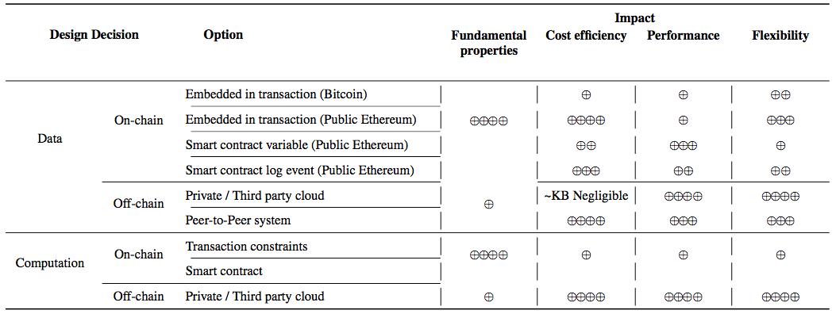
Design Decisions and Their Impact
Notes:
Overview on design decision regarding on-chain and off-chain and their impact.
There are different ways to add a piece of arbitrary data on blockchain. It can be embedded in transaction, or as a smart contract variable or a smart contract log event.
Off-chain also has different options, like private cloud or cloud infrastructure provided by third parity cloud provider. Or a peer-to-peer system

Slide 47

On-chain Data
Colour coin as On-chain auxiliary data
Overlays on Bitcoin to represent real world assets
A common practice of storing item data
Raw data off-chain
On-chain just meta-data, small critical data and hashes of the raw data
On-chain data not just for integration with external data
Store data in Bitcoin
OP_RETURN (limited to 40 bytes)
Slow and costly
Store data in Ethereum
Storing arbitrary data in transaction
Transaction size is limited by the maximum size of a block
Practically smaller transactions accepted by other users
Storing data in smart contract
As variable in a smart contract
As a log event of a smart contract
Variable is more efficient to manipulate, but less flexible due to the constraints of language
Notes:
In the Bitcoin blockchain, the special OP_RETURN is introduced to add arbitrary data into a bitcoin transaction.
Storing data on the Bitcoin blockchain is slow and costly, and the data size is limited to 40 bytes.
When store a data on Ehterum, the size of a transaction is limited by the maximum size of a block,
and in practice transactions typically need to be smaller to be accepted due to the transaction load from other users.
Data can be stored in smart contract as a variable or as a log event. Variable is more efficient to manipulate, but less flexible due to the constraints of the language
However, on chain data is not just for integration with external data.
There are various uses for wholly on-chain auxiliary data, including e.g. “coloured coins” which an overlays on Bitcoin to represent and manage real world assets.

Slide 48
Cost Model
Monetary cost of using public blockchains follows a different cost model than conventional software systems
More expensive
One-time cost for permanent storage
Partial refund of Ethereum
Notes:
- Monetary cost of using public blockchains follows a different cost model than conventional software systems
It is More expensive
One-time cost for permanent storage
Ethereum supports partial refund if a variable is deleted from the Ethereum blockchain.

Slide 49


Off-chain Data Storage
Concern the interaction between blockchain and data storage facilities
Cloud storage
Private cloud on the client’s infrastructure
Public storage provided by a third party
Data replication is managed by the system or consumer
Peer-to-peer data storage
IPFS (InterPlanetary File System)
Free, but availability depends on IPFS server that hosts the data
StorJ
Data is replicated automatically, or based on the user behavior
Notes:
Selection of off-chain data storage concerns the interaction between the blockchain and the conventional data storage facilities.
Off-chain data storage can be through conventional enterprise IT systems
The flexibility of using cloud to store data depends on the implementation, including private cloud on the client’s infrastructure, or public storage provided by a third party provider
In a cloud environment, data replication needs to be managed by the system or consumer.
Some peer-to-peer data storage facilities are designed to be friendly to blockchain, such as IPFS and Storj.
In a peer-to-peer data storage, data is replicated automatically, or based on the user behavior, for example, replicate once a user accesses it.

Slide 50
Student Task
Consider the case of exam registration in UNSW
Think about off-chain data storage in this context: where would it be applicable?
50 |

Slide 51
Design Decisions and Their Impact
Notes:
- Computation in a blockchain-based system can be performed on-chain (e.g., either as transaction constraints or smart contracts) or off-chain.

Slide 52
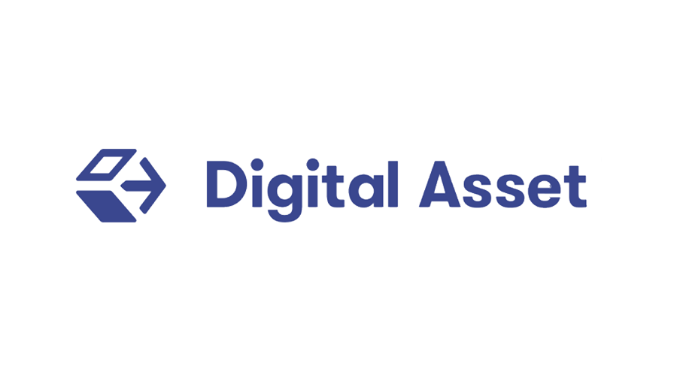
Computation
Non-determinism
Blocks impose an order on transactions
Resolving non-determinism might affect the execution results
Different levels of expressiveness of on-chain computation
Bitcoin only allows simple scripts and conditions
Satisfied to transfer Bitcoin payment
Ethereum provides a Turing complete programming language
Not only perform conditional payments
Make modification to the working data in smart contract variables
DAML (Digital Asset Modelling Language)
More expressive than Bitcoin Script
Purposefully not Turing-complete: codify financial rights and obligations
In order to facilitate static analysis
Benefit of on-chain computation
Inherent interoperability among the systems built on the same blockchain network
Neutrality of execution environment
Immutability of the program code once deployed
Notes:
There are different levels of expressiveness of on-chain computation: Bitcoin only allows simple scripts and conditions, which needs to be satisfied to transfer Bitcoin payment
Ethereum provides a Turing complete programming language, which not only perform conditional payments, but also make modification to the working data in smart contract variables-
DAML (Digital Asset Modelling Language), More expressive than Bitcoin Script, Purposefully not Turing-complete. In order to facilitate static analysis
Smart contracts are not processed until their invoking transactions are included in a new block.
Blocks impose an order on transactions, thus resolving non-determinism which might otherwise affect their execution results
Benefit of on-chain computation
Inherent interoperability among the systems built on the same blockchain network
Neutrality of execution environment
Immutability of the program code once deployed

Slide 53
Impact of Other Components
Other components in the broader system has impact on design decisions
What’s on-chain vs. what’s off-chain
Identity management
Supports systems where is a requirement to know individual human or system involved in transactions
International payments have regulatory requirement to establish identity of participants
AML (Anti-Money Laundering) and CTF (Counter-Terrorism Financing)
Real-world identity is not required from technical perspective
Bitcoin transacting agents are only cryptographically identified
International exchange can be performed without establishing real-world identity
AML/CTF requirements are not obviated by the use of blockchain
Off-chain protocol might be used to store identity information
Privacy and confidentiality can be a challenge when storing on-chain
Notes:
Deciding between on-chain and off-chain not only depends on trade-offs among quality attributes
but also on how information and computation is used by other components in the broader system.
Identity management supports systems where there is a requirement to know the individual human or system involved in transactions.
Services such as international payments have regulatory requirements to establish the identity of participants,
From a purely technical perspective, real-world identities are not necessarily required.
For example on Bitcoin, transacting agents (which are not necessarily persons) are only cryptographically identified, pseudonymously.
So international exchange of the Bitcoin digital currency can be performed without establishing real- world identity.
However, regulatory requirements are not obviated by the use of a blockchain.
Identity is critical here, and identity on blockchain is sometimes considered to be a key enabler for many financial services on blockchain.
Identity information does not necessarily need to be stored on-chain, off-chain protocols might be used instead.
Privacy and confidentiality can be a challenge when integrating identity information into a blockchain-based system.

Slide 54
Student Task
Consider the case of exam registration, as before
Think about which parts of the computation to perform on-chain and which parts off-chain.
54 |

Slide 55
Blockchain Selection
Blockchain platform is selected
Requirement of the use case
Characteristics of blockchain platform
Trade-off analysis
Consensus protocol and other decisions are fixed once blockchain is selected
Hyperledger Fabric is an exception
Support pluggable implementations of various consensus protocols
Inter-block time is configurable for Proof-of-Work protocol
Through adjustments to the difficulty of mining
Notes:
The next step is to select and configure blockchain
Blockchain platform is selected based on requirement of the use case, characteristics of blockchain platform, and trade-off analysis.
Consensus protocol and other decisions are fixed once blockchain platform is selected
Hyperledger is an exception, which supports pluggable implementations of various consensus protocols
Inter-block time is configurable for Proof-of-Work protocol
Through adjustments to the difficulty of mining

Slide 56
Deployment
Deployment has impact on quality attributes
Deploying on cloud or using BaaS (Blockchain-as-a-Service)
Introduces the uncertainty of cloud infrastructure
Cloud provider becomes a trusted third-party and a single point of failure
Deploying a public blockchain on a VPN (virtual private network)
Becomes a private blockchain
Permissioned access controls provided at the network level
VPN introduces additional network latency overhead
Notes:
The last step is deployment and operation
the choice of where to deploy the modules of the blockchain-based system is also important for the quality attributes of blockchain-based systems.
The system can be deployed on cloud or using BaaS (Blockchain-as-a-Service)
In this case, it introduces the uncertainty of cloud infrastructure
Cloud provider becomes a trusted third-party and a single point of failure
It can be a public blockchain deployed on a VPN (virtual private network)
In this case, it becomes a private blockchain with permissioned access controls provided at the network level
VPN introduces additional network latency overhead

Slide 57
Student Task
Consider the case of exam registration, as before
But imagine we use one system for all universities in Australia
Take half a minute to think about where to deploy a blockchain for this context
57 |

Slide 58
Operation
Operation challenges
Blockchain-based systems can be harder to modify than conventional systems
Blockchain platform software running on multiple independently-operating nodes
Updating software can by physically and administratively difficult to coordinate
Blockchain is immutable by design, so cannot be retrospectively updated
Trust is derived partly from the fact that the smart contract cannot be changed easily
Governance
Changes may be made to correct defects, add features or migrate to new IT context
More like diplomacy in multi-party system with no single owner
Blockchain is NOT SUITABLE to a system that needs to change frequently
Learn from governance in open-source software
Governance concerns software development, deployment and operation
Immutable smart contract also simplify governance to some degree
Smart contract is available for execution while the blockchain operates normally
Notes:
There are specific design challenges related to the operation of blockchain-based systems
Blockchain platform software running on multiple independently-operating nodes, Updating software can by physically and administratively difficult to coordinate
The blockchain ledger is immutable by design, and so cannot be updated to facilitate system modification.
In blockchain-based systems that use smart contracts to regulate interactions between mutually-untrusting parties, trust is derived partly from the fact that the code cannot be changed easily.
This creates challenges for governance: the management of the evolution of blockchain-based systems.
However, in a multi-party system with no single owner, managing these changes is more like diplomacy than traditional risk management or conventional product management.
Lessons may be drawn from governance in open-source software, which face similar development challenges.
For both public and private blockchain systems, key stake- holders include the users of the blockchain, software developers, miners or processing nodes in the blockchain ecosystem, and government regulators in related industries.
However, blockchain immutability may also simplify governance oversight to some degree.
Smart contracts deployed on a blockchain will be resistant to tampering, and will continue to be available for execution while the whole blockchain operates normally.
These factors should be taken into consideration when deciding to use blockchain as a component within a software system.

Slide 59
Summary
Suitability needs to be evaluated first
Fundamental properties and limitations of blockchain
Each step of the design process is a design decision
On-chain vs. off-chain
Subsidiary design decisions
Notes:
In this topic, We learned an architecture analysis method, called ATAM.
We then learned a design process for blockchain applications.
For a system that can potentially use blockchain, the first design choice is to decide whether to use a blockchain or conventional technologies.
Often in a blockchain-based system, some data is stored on the blockchain while other data is stored and communicated using conventional technologies, so another design choice is which data should be stored where.
When using a blockchain, there are subsidiary design choices including whether to use a private blockchain or a public blockchain, what consensus protocol is best, and what the block frequency should be. These decision decisions need to be also carefully considered during the design process.

Slide 60

Thank You
Xiwei Xu | Senior Research Scientist
Architecture & Analytics Platforms (AAP) team
T +61 2 9490 5664
E xiwei.xu@data61.csiro.au
W www.data61.csiro.au/

